Slide 1
ADMINISTRATOR
Administrator manage governors.
Add, remove or appoint governor.

Slide 2
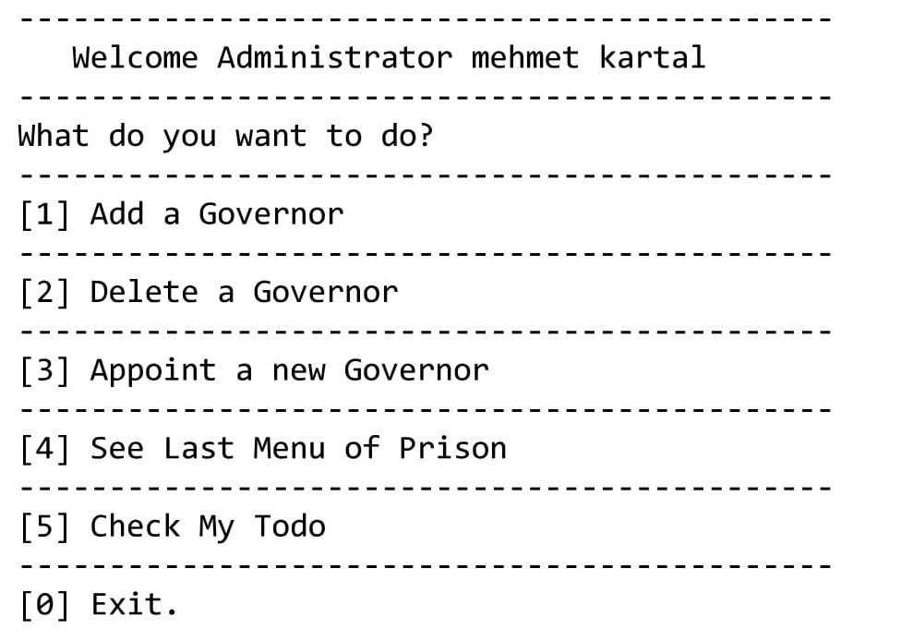
ADMINISTRATOR
When Administrator enters the system, Shown a menu like as right picture.

Slide 3
addGovernor
User enters ID, name, surname, password, blood group, last control result, height, weight, pulse, shift time, shift days, block and floor.
removeGovernor
User enters ID to remove.
appointGovernor
User first enters ID to remove, then enters ID, name, surname, password, blood group, last control result, height, weight, pulse, shift time, shift days, block and floor to add.

